Slide 1

COMP491 SenIor Desıgn Project I 2D Story-based Ai Supported Game Design
AdvIsor :
Tuna Çakar
Team Members :
Atakan Ermete
Muhammed Rahmetullah Kartal
Zeynep Ayyüce Çay

Slide 2
CONTENT
Set in an imaginary World, this game is a story-driven 2D RPG. The goal is to add a new viewpoint to the game industry by encouraging Artificial Intelligence (AI) in-game quests and story flow in accordance with the player's decisions during the game. You play the game as an American army soldier against Nazi Germany in Second World War.

Slide 3
OUR PLANS

Slide 4
ARTIFICIAL INTELLIGENCE
The story in this game consists of many quests. The role of artificial intelligence is to provide a more competitive game to the player in these quests, depending on the game type and choices of the player. The use of artificial intelligence in quests will be like a 3x3 isolation game.

Slide 5
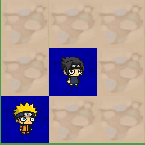
ARTIFICIAL
INTELLIGENCE

Slide 6
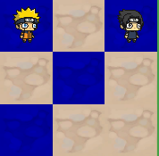
ARTIFICIAL
INTELLIGENCE

Slide 7
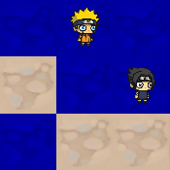
ARTIFICIAL
INTELLIGENCE

Slide 8
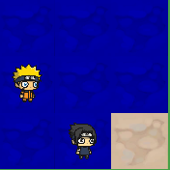
ARTIFICIAL
INTELLIGENCE

Slide 9
THE STORY

Slide 10
CHARACTERS

Slide 11
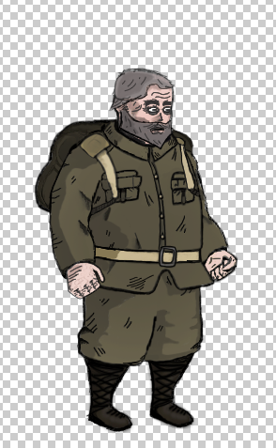
OLD MAN

Slide 12
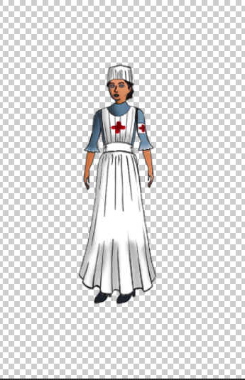
NURSE

Slide 13
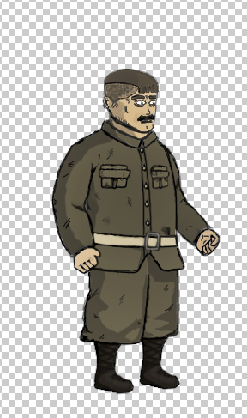
SOLDIER

Slide 14
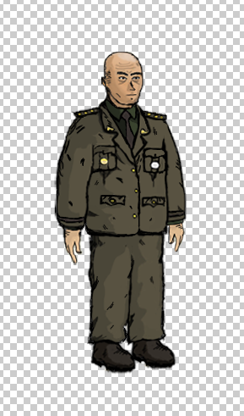
COMMANDER

Slide 15
ENVIRONMENT

Slide 16
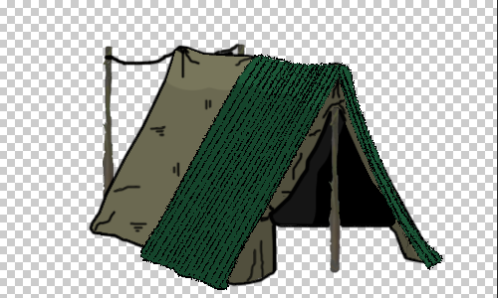
SOLDIER TENT

Slide 17
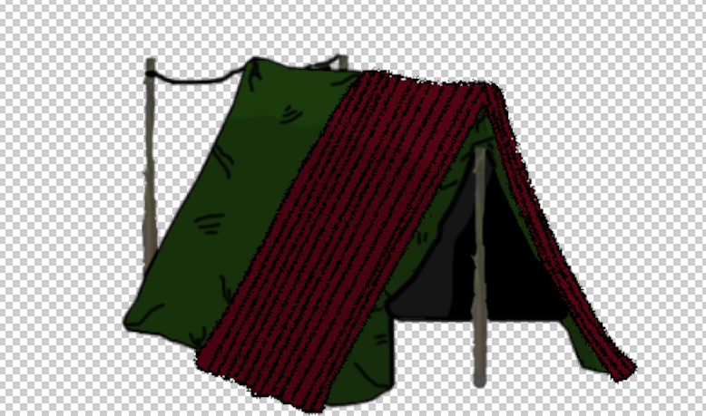
COMMANDER TENT

Slide 18
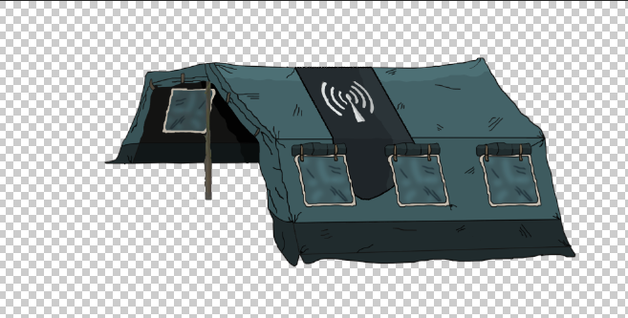
COMMUNICATION TENT

Slide 19
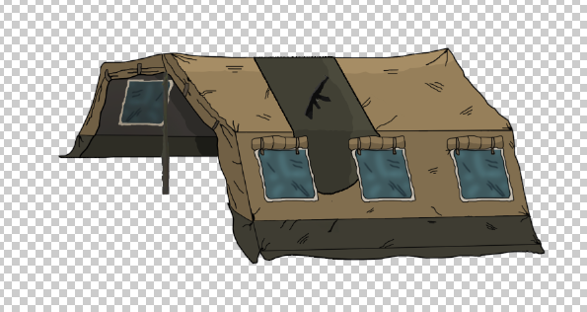
EQUIPMENT TENT

Slide 20
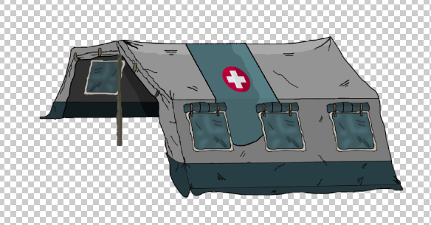
HEALTH TENT

Slide 21
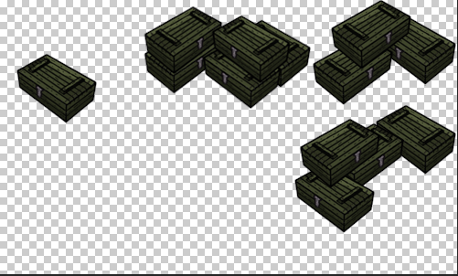
BOXES

Slide 22
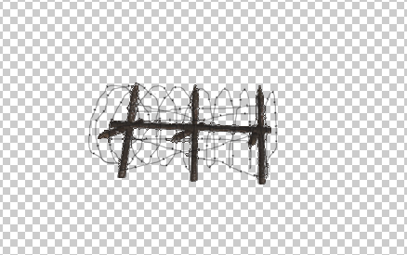
BARBED WIRE

Slide 23
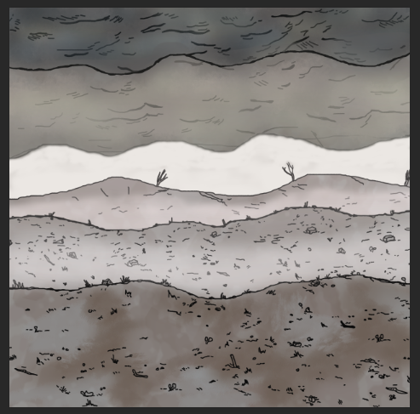
BACKGROUND

Slide 24
ANIMATIONS

Slide 25
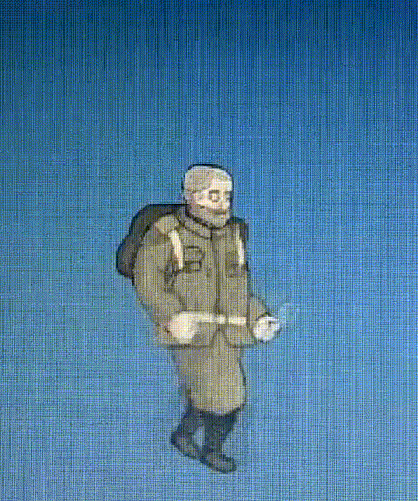
OLD MAN ANIMATION

Slide 26
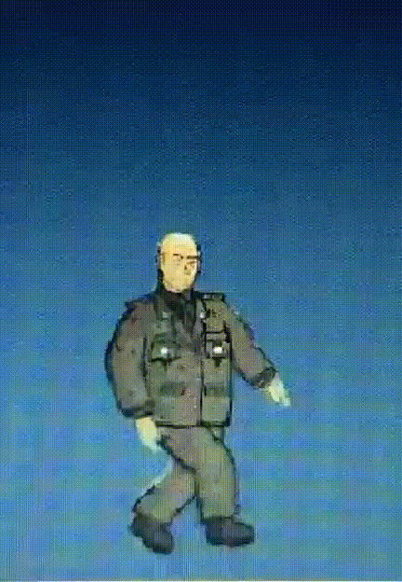
COMMANDER ANIMATION

Slide 27
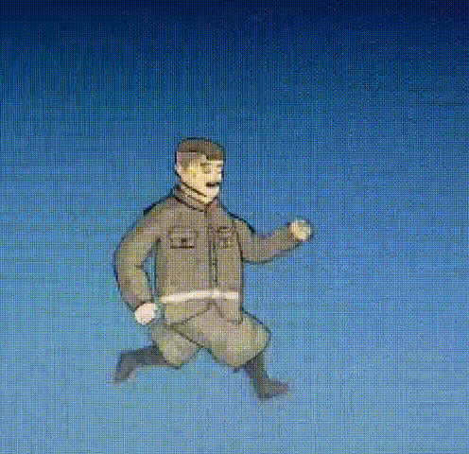
SOLDIER ANIMATION

Slide 28
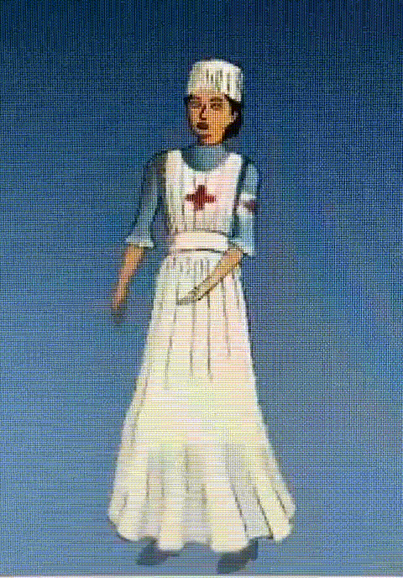
Nurse anımatıon

Slide 29
Conclusıon
By completing this project, we are going to learn importance of teamwork, timing, and selfless working. Since the start of project all the team members are trying to learn photoshop (artworks), unity(animations) and C# coding principles while studying on different Artificial Intelligence models, ideas. While doing these processes watched a lot of videos from YouTube and found good models from different movies, games etc. On the teamwork part we tried to share artworks and animations equally because we were all new to these ideas.

Slide 30
thank you for your attention

